Slide 1
Memory Management Strategies

Slide 2
8.1.1 Basic Hardware
Main memory and the registers built into the processor itself are the only storage that the CPU can access directly. There are machine instructions that take memory addresses as arguments, but none that take disk addresses. Therefore, any instructions in execution, and any data being used by the instructions, must be in one of these direct-access storage devices. If the data are not in memory, they must be moved there before the CPU can operate on them.
Registers that are built into the CPU are generally accessible within one cycle of the CPU clock. The same cannot be said of main memory, which is accessed via a transaction on the memory bus. Completing a memory access may take many cycles of the CPU clock. In such cases, the processor normally needs to stall, since it does not have the data required to complete the instruction that it is executing.
The fast memory between the CPU and main memory is called as cache.
we must ensure correct operation to protect the operating system from access by user processes and, in addition, to protect user processes from one another. This protection must be provided by the hardware. It can be implemented in several ways. In this section, we outline one possible implementation.

Slide 3
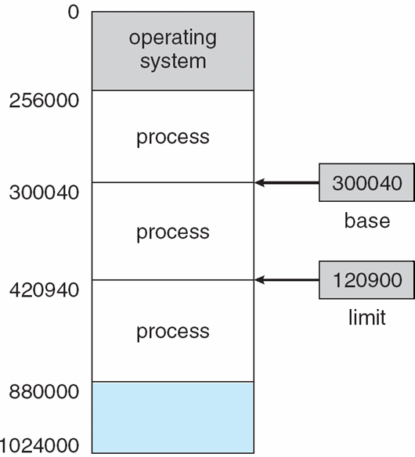
Continued….
We first need to make sure that each process has a separate memory space. To do this, we need the ability to determine the range of legal addresses that the process may access and to ensure that the process can access only these legal addresses. We can provide this protection by using two registers, usually a base and a limit, as illustrated in Figure 8.1.
The base register holds the smallest legal physical memory address and limit register the specifies the size of the range. For example, if the base register holds 300040 and the limit register is 120900, then the program can legally access all addresses from 300040 through 420939 (inclusive).
Figure 8.1 A base and a limit register define a logical address space.

Slide 4
Continued….
Protection of memory space is accomplished by having the CPU hardware compare every address generated in user mode with the registers. Any attempt by a program executing in user mode to access operating-system memory or other users' memory results in a trap to the operating system, which treats the attempt as a fatal error (Figure 8.2). This scheme prevents a user program from (accidentally or deliberately) modifying the code or data structures of either the operating system or other users.
The base and limit registers can be loaded only by the operating system, which uses a special privileged instruction. Since privileged instructions can be executed only in kernel mode, and since only the operating system executes in kernel mode, only the operating system can load the base and limit registers.
Figure 8.2 Hardware address protection with base and limit registers

Slide 5
8.1.2 Address Binding
The processes on the disk that are waiting to be brought into memory for execution form the input queue.
The normal procedure is to select one of the processes in the input queue and to load that process into memory. As the process is executed, it accesses instructions and data from memory. Eventually, the process terminates, and its memory space is declared available.
Most systems allow a user process to reside in any part of the physical memory. Thus, although the address space of the computer starts at 00000, the first address of the user process need not be 00000. This approach affects the addresses that the user program can use. In most cases, a user program will go through several steps-some of which may be optional-before being executed (Figure 8.3).
Addresses may be represented in different ways during these steps. Addresses in the source program are generally symbolic (such as count). A compiler will typically bind these symbolic addresses to relocatable addresses (such as "14 bytes from the beginning of this module").
The linkage editor or loader will in turn bind the relocatable addresses to absolute addresses (such as 74014). Each binding is a mapping from one address space to another.

Slide 6
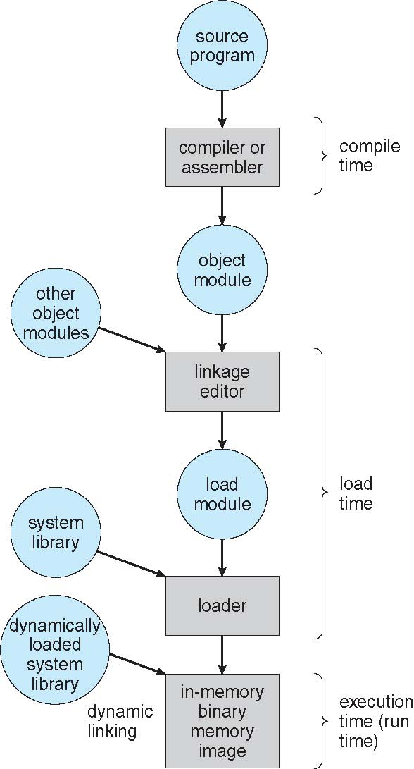
Continued….
Figure 8.3 Multistep processing of a user program

Slide 7
Continued….
Classically, the binding of instructions and data to memory addresses can be done at any step along the way:
Compile time. If you know at compile time where the process will reside in memory, then absolute code can be generated. For example, if you know that a user process will reside starting at location R, then the generated compiler code will start at that location and extend up from there. If, at some later time, the starting location changes, then it will be necessary to recompile this code. The MS-DOS.COM-format programs are bound at compile time.
Load time. If it is not known at compile time where the process will reside in memory, then the compiler must generate relocatable code. In this case, final binding is delayed until load time. If the starting address changes, we need only reload the user code to incorporate this changed value.
Execution time. If the process can be moved during its execution from one memory segment to another, then binding must be delayed until run time.

Slide 8
8.1.3 Logical versus Physical Address Space
An address generated by the CPU is commonly referred to as a logical address.
whereas an address seen by the memory unit-that is, the one loaded into memory address register of the memory is commonly referred to as a physical address.
The compile-time and load-time address-binding methods generate identical logical and physical addresses. However, the execution-time address binding scheme results in differing logical and physical addresses. The logical address is also called as virtual address.
The set of all logical addresses generated by a program is a logical address space.
The set of all physical addresses corresponding to these logical addresses is a physical address space. The run-time mapping from virtual to physical addresses is done by a hardware device called memory management unit(MMU).
The base register is now called a relocation register as shown in figure 8.4(next slide). The value in the relocation register is added to every address generated by a user process at the time the address is sent to memory.
For example, if the base is at 14000, then an attempt by the user to address location 0 is dynamically relocated to location 14000; an access to location 346 is mapped to location 14346.

Slide 9
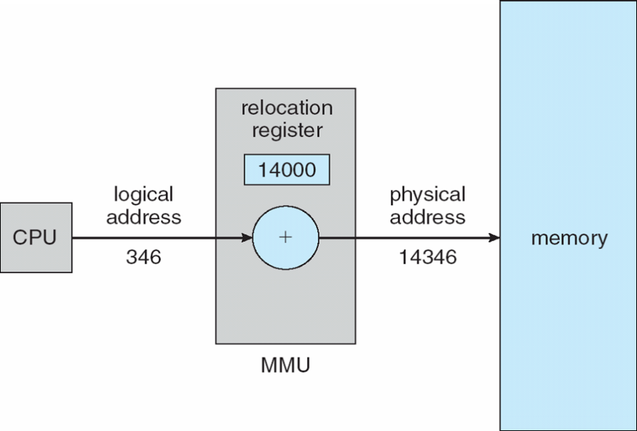
Continued….
Figure 8.4 Dynamic relocation using a relocation register.
The user program never sees the real physical addresses. The program can create a pointer to location 346, store it in memory, manipulate it, and compare it with other addresses-all as the number 346. Only when it is used as a memory address (in an indirect load or store, perhaps) is it relocated relative to the base register. The user program deals with logical addresses. The memory-mapping hardware converts logical addresses into physical addresses.
We now have two different types of addresses: logical addresses (in the range 0 to max) and physical addresses (in the rangeR+ 0 toR+ max for a base valueR). The user generates only logical addresses and thinks that the process runs in locations 0 to max.

Slide 10
8.1.4 Dynamic Loading
To obtain better memory-space utilization, we can use dynamic loading. With dynamic loading, a routine is not loaded until it is called.
All routines are kept on disk in a relocatable load format. The main program is loaded into memory and is executed. When a routine needs to call another routine, the calling routine first checks to see whether the other routine has been loaded. If it has not, the relocatable linking loader is called to load the desired routine into memory and to update the program's address tables to reflect this change. Then control is passed to the newly loaded routine.
The advantage of dynamic loading is that an unused routine is never loaded. This method is particularly useful when large amounts of code are needed to handle infrequently occurring cases, such as error routines.

Slide 11
8.1.5 Dynamic Linking and Shared Libraries
Some operating systems support only static linking in which system language libraries are treated like any other object module and are combined by the loader into the binary program image.
Dynamic linking, in contrast, is similar to dynamic loading. Here, though, linking, rather than loading, is postponed until execution time. This feature is usually used with system libraries, such as language subroutine libraries. Without this facility, each program on a system must include a copy of its language library (or at least the routines referenced by the program) in the executable image. This requirement wastes both disk space and main memory.
With dynamic linking, a stub is included in the image for each library routine reference. The stub is a small piece of code that indicates how to locate the appropriate memory-resident library routine or how to load the library if the routine is not already present. When the stub is executed, it checks to see whether the needed routine is already in memory. If it is not, the program loads the routine into memory.
Either way, the stub replaces itself with the address of the routine and executes the routine. Thus, the next time that particular code segment is reached, the library routine is executed directly, incurring no cost for dynamic linking.
This feature can be extended to library updates (such as bug fixes). A library may be replaced by a new version, and all programs that reference the library will automatically use the new version. Without dynamic linking, all such programs would need to be relinked to gain access to the new library.

Slide 12
Continued…
More than one version of a library may be loaded into memory, and each program uses its version information to decide which copy of the library to use. Versions with minor changes retain the same version number, whereas versions with major changes increment the number. Thus, only programs that are compiled with the new library version are affected by any incompatible changes incorporated in it. Other programs linked before the new library was installed will continue using the older library. This system is also known as shared libraries.

Slide 13
8.2 swapping
A process must be in memory to be executed. A process, however, can be swapped temporarily out of memory to a backing store and then brought back into memory for continued execution.
For example, assume a multiprogramming environment with a round-robin CPU-scheduling algorithm. When a quantum expires, the memory manager will start to swap out the process that just finished and to swap another process into the memory space that has been freed (Figure 8.5).
In the meantime, the CPU scheduler will allocate a time slice to some other process in memory. When each process finishes its quantum, it will be swapped with another process. Ideally, the memory manager can swap processes fast enough that some processes will be in memory, ready to execute, when the CPU scheduler wants to reschedule the CPU.
A variant of this swapping policy is used for priority-based scheduling algorithms. If a higher-priority process arrives and wants service, the memory manager can swap out the lower-priority process and then load and execute the higher-priority process. When the higher-priority process finishes, the lower-priority process can be swapped back in and continued. The variant of swapping is also called as roll out and roll in.
Normally, a process that is swapped out will be swapped back into the same memory space it occupied previously. This restriction is dictated by the method of address binding. If binding is done at assembly or load time, then the process cannot be easily moved to a different location. If execution-time binding is being used, however, then a process can be swapped into a different memory space, because the physical addresses are computed during execution time.

Slide 14
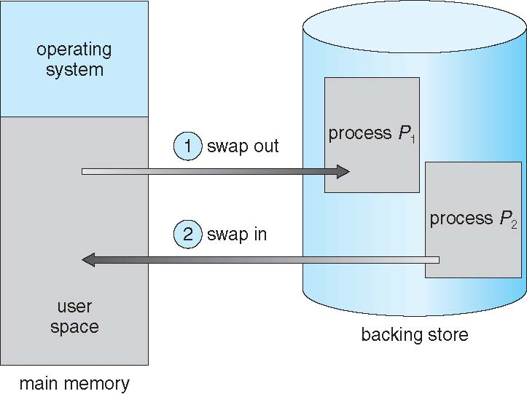
Continued…
Swapping requires a backing store. The backing store is commonly a fast disk. It must be large enough to accommodate copies of all memory images for all users, and it must provide direct access to these memory images. The system maintains a ready queue consisting of all processes whose memory images are on the backing store or in memory and are ready to run.
Whenever the CPU scheduler decides to execute a process, it calls the dispatcher. The dispatcher checks to see whether the next process in the queue is in memory. If it is not, and if there is no free memory region, the dispatcher swaps out a process currently in memory and swaps in the desired process. It then reloads registers and transfers control to the selected process.
Figure 8.5 Swapping of two processes using a disk as a backing store.

Slide 15
Continued…
Swapping is constrained by other factors as well. If we want to swap a process, we must be sure that it is completely idle. Of particular concern is any pending I/0. A process may be waiting for an I/0 operation when we want to swap that process to free up memory. However, if the I/0 is asynchronously accessing the user memory for I/0 buffers, then the process cannot be swapped. Assume that the I/0 operation is queued because the device is busy.
Disadvantages
The context-switch time in such a swapping system is fairly high.
Notice that the major part of the swap time is transfer time. The total transfer time is directly proportional to the amount of memory swapped.
It requires too much swapping time and provides too little execution time to be a reasonable memory-management solution.

Slide 16
8.3 contiguous memory allocation
The main memory must accommodate both the operating system and the various user processes. We therefore need to allocate main memory in the most efficient way possible. This section explains one common method, contiguous memory allocation.
The memory is usually divided into two partitions: one for the resident operating system and one for the user processes. We can place the operating system in either low memory or high memory. The major factor affecting this decision is the location of the interrupt vector. Since the interrupt vector is often in low memory, programmers usually place the operating system in low memory as well.
In contiguous memory allocation, each process is contained in a single contiguous section of memory.
8.3.1 Memory Mapping and Protection
Before discussing memory allocation further, we must discuss the issue of memory mapping and protection. We can provide these features by using a relocation register together with a limit register.
The relocation register contains the value of the smallest physical address; the limit register contains the range of logical addresses.
With relocation and limit registers, each logical address must be less than the limit register; the MMU maps the logical address dynamically by adding the value in the relocation register. This mapped address is sent to memory (Figure 8.6).
When the CPU scheduler selects a process for execution, the dispatcher loads the relocation and limit registers with the correct values as part of the context switch. Because every address generated by a CPU is checked against these registers, we can protect both the operating system and the other users‘ programs and data from being modified by this running process.

Slide 17
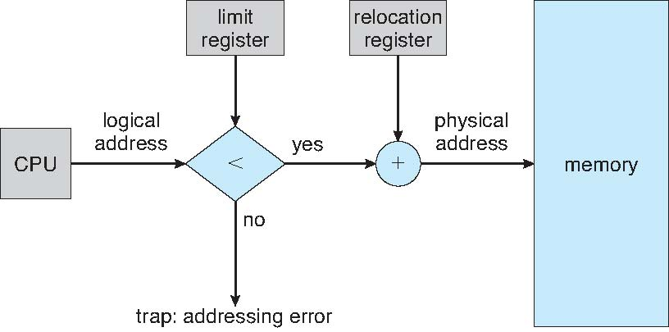
Continued…..
Figure 8.6
8.3.2 Memory Allocation
Now we are ready to turn to memory allocation. One of the simplest methods for allocating memory is to divide memory into several fixed-sized partition. Each partition may contain exactly one process. Thus, the degree of multiprogramming is bound by the number of partitions. In this multiprogramming method when a partition is free, a process is selected from the input queue and is loaded into the free partition. When the process terminates, the partition becomes available for another process.
In the variable partition scheme, the operating system keeps a table indicating which parts of memory are available and which are occupied. Initially, all memory is available for user processes and is considered one large block of available memory a hole. Eventually as you will see, memory contains a set of holes of various sizes.

Slide 18
Continued….
As processes enter the system, they are put into an input queue. At any given time, then, we have a list of available block sizes and an input queue. The operating system can order the input queue according to a scheduling algorithm. Memory is allocated to processes until finally, the memory requirements of the next process cannot be satisfied that is, no available block of memory (or hole) is large enough to hold that process. The operating system can then wait until a large enough block is available, or it can skip down the input queue to see whether the smaller memory requirements of some other process can be met.
In general as mentioned, the memory blocks available comprise a set of holes of various sizes scattered throughout memory. When a process arrives and needs memory, the system searches the set for a hole that is large enough for this process. If the hole is too large, it is split into two parts. One part is allocated to the arriving process; the other is returned to the set of holes. When a process terminates, it releases its block of memory, which is then placed back in the set of holes. If the new hole is adjacent to other holes, these adjacent holes are merged to form one larger hole. At this point, the system may need to check whether there are processes waiting for memory and whether this newly freed and recombined memory could satisfy the demands of any of these waiting processes.
This procedure is a particular instance of the general dynamic storage allocation problem which concerns how to satisfy a request of size n from list of free holes. There are many solutions to this problem. The first-fit, best-fit and worst fit strategies are the ones most commonly used to select a free hole from the set of available holes.

Slide 19
Continued…
First fit. Allocate the first hole that is big enough. Searching can start either at the beginning of the set of holes or at the location where the previous first-fit search ended. We can stop searching as soon as we find a free hole that is large enough.
Best fit. Allocate the smallest hole that is big enough. We must search the entire list, unless the list is ordered by size. This strategy produces the smallest leftover hole.
Worst fit. Allocate the largest hole. Again, we must search the entire list, unless it is sorted by size. This strategy produces the largest leftover hole, which may be more useful than the smaller leftover hole from a best-fit approach.
8.3.3 Fragmentation
Both the first-fit and best-fit strategies for memory allocation suffer from external fragmentation. As processes are loaded and removed from memory, the free memory space is broken into little pieces. External fragmentation exists when there is enough total memory space to satisfy a request but the available spaces are not contiguous; storage is fragmented into a large number of small holes. This fragmentation problem can be severe.
Whether we are using the first-fit or best-fit strategy can affect the amount of fragmentation. Depending on the total amount of memory storage and the average process size, external fragmentation may be a minor or a major problem. Statistical analysis of first fit, for instance, reveals that, even with some optimization, given N allocated blocks, another 0.5 N blocks will be lost to fragmentation. That is, one-third of memory may be unusable! This property is known as the 50 percent rule.

Slide 20
Continued…
Memory fragmentation can be internal as well as external. Consider a multiple-partition allocation scheme with a hole of 18,464 bytes. Suppose that the next process requests 18,462 bytes. If we allocate exactly the requested block, we are left with a hole of 2 bytes. The overhead to keep track of this hole will be substantially larger than the hole itself. So the internal fragmentation is the memory that is internal to a partition.
One solution to the problem of external fragmentation is compaction. The goal is to shuffle the memory contents so as to place all free memory together in one large block. Compaction is not always possible, however. If relocation is static and is done at assembly or load time, compaction cannot be done. compaction is possible only if relocation is dynamic and is done at execution time.
Another possible solution to the external-fragmentation problem is to permit the logical address space of the processes to be noncontiguous, thus allowing a process to be allocated physical memory wherever such memory is available. Paging and segmentation techniques can be used.

Slide 21
8.4 Paging
Paging is a memory memory-management scheme that permits the physical address space of a process to be noncontiguous. Paging avoids external fragmentation and the need for compaction. It also solves the considerable problem of fitting memory chunks of varying sizes onto the backing store; most memory management schemes used before the introduction of paging suffered from this problem.
8.4.1 Basic Method
The basic method for implementing paging involves breaking physical memory into fixed-sized blocks called frames. breaking logical memory into blocks of the same size called pages. When a process is to be executed, its pages are loaded into any available memory frames from their source. The backing store is divided into fixed-sized blocks that are of the same size as the memory frames.
The hardware support for paging is illustrated in Figure 8.7(next slide). Every address generated the CPU is divided into two parts: i) a page number ii) page offset. The page number is used as an index into a page table. The page table contains the base address of each page in physical memory. This base address is combined with the page offset to define the physical memory address that is sent to the memory unit. The paging model of memory is shown in Figure 8.8.
The page size (like the frame size) is defined by the hardware. The size of a page is typically a power of 2, varying between 512 bytes and 16 MB per page, depending on the computer architecture. The selection of a power of 2 as a page size makes the translation of a logical address into a page number and page offset particularly easy.

Slide 22
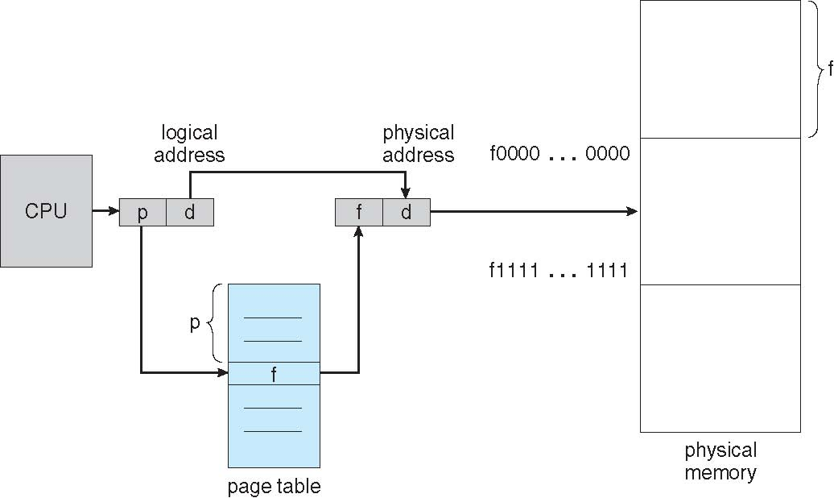
Continued…
If the size of the logical address space is 2^m, and a page size is 2^n addressing units (bytes or words) then the high-order m- n bits of a logical address designate the page number, and the n low-order bits designate the page offset. where p is an index into the page table and d is the displacement within the page.
Figure 8.7 Paging hardware.

Slide 23
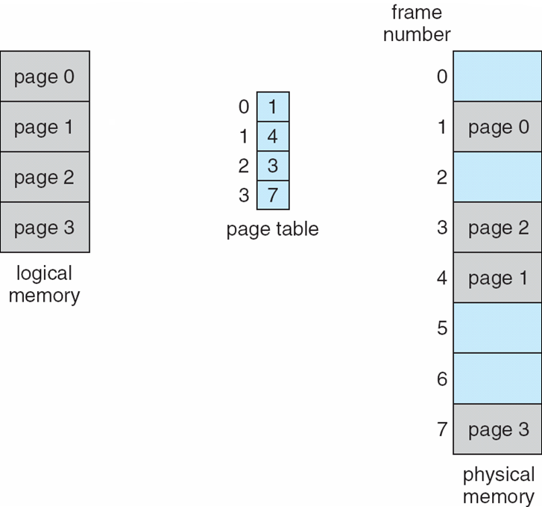
Continued…
Paging Model of Logical and Physical Memory
Example :
As a concrete (although minuscule) example, consider the memory in Figure 8.9(next slide). Here, in the logical address, n= 2 and m = 4. Using a page size of 4 bytes and a physical memory of 32 bytes (8 pages), we show how the user's view of memory can be mapped into physical memory. Logical address 0 is page 0, offset 0. Indexing into the page table, we find that page 0 is in frame 5. Thus, logical address 0 maps to physical address 20 [= (5 x 4) + 0]. Logical address 3 (page 0, offset 3) maps to physical address 23 [ = (5 x 4) + 3]. Logical address 4 is page 1, offset 0; according to the page table, page 1 is mapped to frame 6. Thus, logical address 4 maps to physical address 24 [ = ( 6 x 4) + O]. Logical address 13 maps to physical address 9.

Slide 24
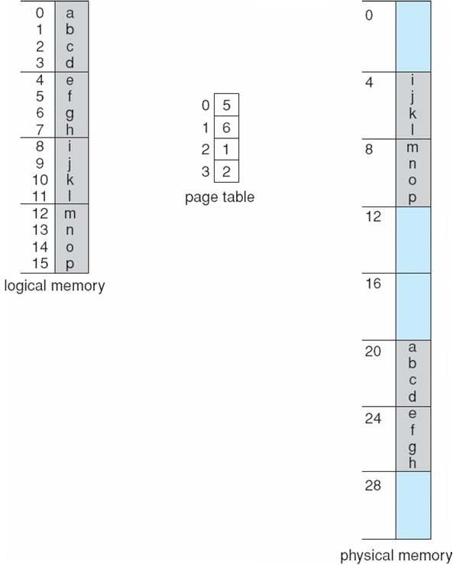
Continued…
Figure 8.9 Paging example for a 32-byte memory with 4-byte pages.
Advantages of paging
When we use a paging scheme, we have no external fragmentation: any free frame can be allocated to a process that needs it.
Disadvantages
However, we may have some internal fragmentation. Notice that frames are allocated as units. If the memory requirements of a process do not happen to coincide with page boundaries, the last frame allocated may not be completely full.
It increases context switch time.

Slide 25
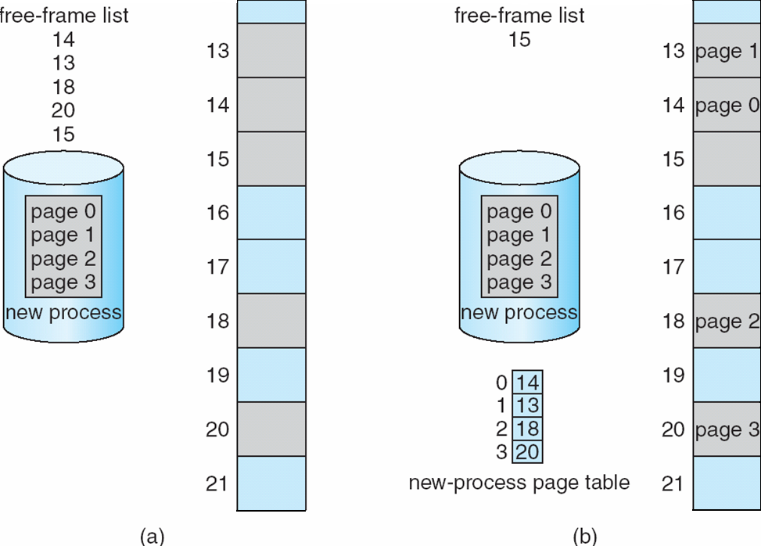
Continued….
Since the operating system is managing physical memory, it must be aware of the allocation details of physical memory-which frames are allocated, which frames are available, how many total frames there are, and so on. This information is generally kept in a data structure called a frame table.
The frame table has one entry for each physical page frame, indicating whether the latter is free or allocated and, if it is allocated, to which page of which process or processes.
Before allocation after allocation

Slide 26
8.4.2 Hardware Support
Each operating system has its own methods for storing page tables. Most allocate a page table for each process. A pointer to the page table is stored with the other register values (like the instruction counter) in the process control block. When the dispatcher is told to start a process, it must reload the user registers and define the correct hardware page-table values from the stored user page table.
The hardware implementation of the page table can be done in several ways. In the simplest case, the page table is implemented as a set of dedicated registers. These registers should be built with very high-speed logic to make the paging-address translation efficient. Every access to memory must go through the paging map, so efficiency is a major consideration.
The use of registers for the page table is satisfactory if the page table is reasonably small (for example, 256 entries). Most contemporary computers, however, allow the page table to be very large (for example, 1 million entries). For these machines, the use of fast registers to implement the page table is not feasible. Rather, the page table is kept in main memory, and a page table base register (PTBR) points to the page table. Changing page tables requires changing only this one register, substantially reducing context-switch time.
The problem with this approach is the time required to access a user memory location. If we want to access location i, we must first index into the page table, using the value in the PTBR offset by the page number for i. This task requires a memory access. It provides us with the frame number, which is combined with the page offset to produce the actual address. We can then access the desired place in memory. With this scheme, two memory accesses are needed to access a byte (one for the page-table entry, one for the byte). Thus, memory access is slowed by a factor of 2. This delay would be intolerable under most circumstances. We might as well resort to swapping!.
The standard solution to this problem is to use a special, small, fast lookup hardware cache, called a translation look aside buffer.

Slide 27
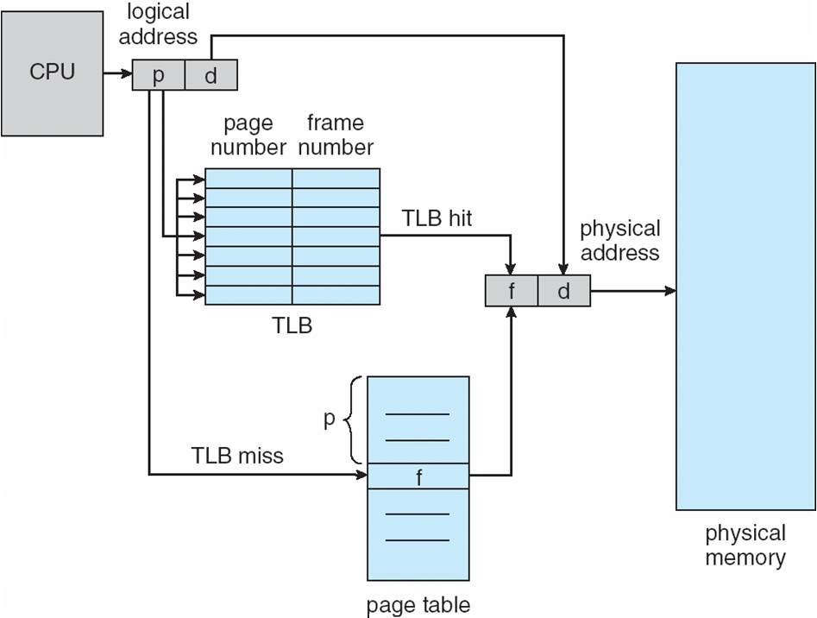
Translation look aside buffer
The TLB is associative, high-speed memory. Each entry in the TLB consists of two parts: a key (or tag) and a value. When the associative memory is presented with an item, the item is compared with all keys simultaneously. If the item is found, the corresponding value field is returned. The search is fast; the hardware, however, is expensive. Typically, the number of entries in a TLB is small, often numbering between 64 and 1,024.
If the page number is not in the TLB (known as a a memory reference to the page table must be made. When the frame number is obtained, we can use it to access memory (Figure 8.11). In addition, we add the page number and frame number to the TLB, so that they will be found quickly on the next reference. If the TLB is already full of entries, the operating system must select one for replacement. Replacement policies range from least recently used (LRU) to random.
Figure 8.11

Slide 28
Continued…
Some TLBs store address space identifiers(ASID) in each TLB entry. TLB entry. An ASID uniquely identifies each process and is used to provide address-space protection for that process.
When the TLB attempts to resolve virtual page numbers, it ensures that the ASID for the currently running process matches the ASID associated with the virtual page. If the ASIDs do not match, the attempt is treated as a TLB miss. The percentage of times that a particular page number is found in the TLB is called the hit ratio.
An 80-percent hit ratio, for example, means that we find the desired page number in the TLB 80 percent of the time. If it takes 20 nanoseconds to search the TLB and 100 nanoseconds to access memory, then a mapped-memory access takes 120 nanoseconds when the page number is in the TLB. If we fail to find the page number in the TLB (20 nanoseconds), then we must first access memory for the page table and frame number (100 nanoseconds) and then access the desired byte in memory (100 nanoseconds), for a total of 220 nanoseconds.
To find the effective memory access time we weight the case by its probability:
effective access time = 0.80 x 120 + 0.20 x 220= 140 nanoseconds.
In this example, we suffer a 40-percent slowdown in memory-access time.
For a 98-percent hit ratio, we have
effective access time = 0.98 x 120 + 0.02 x 220= 122 nanoseconds.
This increased hit rate produces only a 22 percent slowdown in access time.

Slide 29
8.4.3 Protection
Memory protection in a paged environment is accomplished by protection bits associated with each frame. Normally, these bits are kept in the page table.
One bit can define a page to be read-write or read-only. Every reference to memory goes through the page table to find the correct frame number. At the same time that the physical address is being computed, the protection bits can be checked to verify that no writes are being made to a read-only page. An attempt to write to a read-only page causes a hardware trap to the operating system (or memory-protection violation).
One bit can define a page to be read-write or read-only. Every reference to memory goes through the page table to find the correct frame number. At the same time that the physical address is being computed, the protection bits can be checked to verify that no writes are being made to a read-only page. An attempt to write to a read-only page causes a hardware trap to the operating system (or memory-protection violation).
One additional bit is generally attached to each entry in the page table: a valid-invalid bit.
When this bit is set to "valid," the associated page is in the process's logical address space and is thus a legal (or valid) page. When the bit is set to "invalid," the page is not in the process's logical address space. Illegal addresses are trapped by use of the valid -invalid bit. The operating system sets this bit for each page to allow or disallow access to the page as shown in figure 8.12.

Slide 30
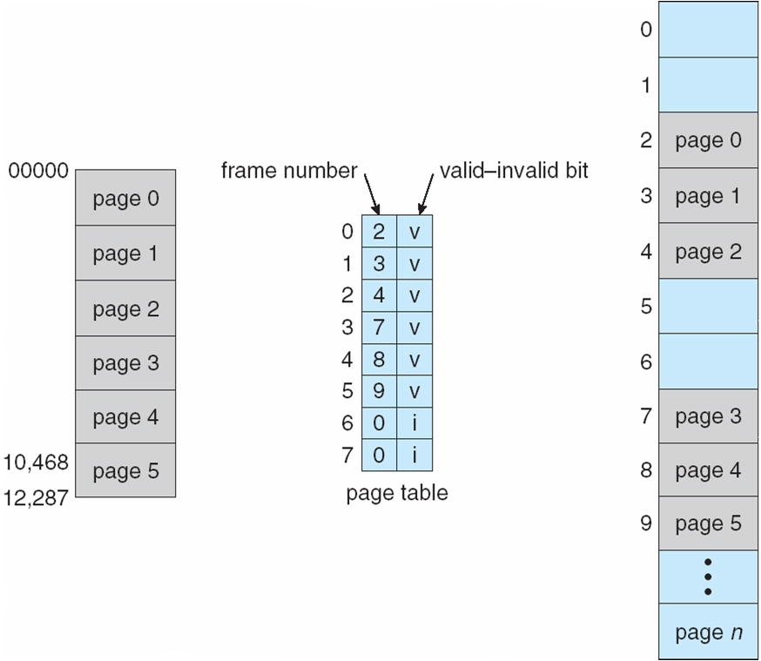
Continued…
When this bit is set to "valid," the associated page is in the process's logical address space and is thus a legal (or valid) page. When the bit is set to "invalid," the page is not in the process's logical address space. Illegal addresses are trapped by use of the valid -invalid bit. The operating system sets this bit for each page to allow or disallow access to the page.
Addresses in pages 0, 1, 2, 3, 4, and 5 are mapped normally through the page table. Any attempt to generate an address in pages 6 or 7, however, will find that the valid -invalid bit is set to invalid, and the computer will trap to flee operating system (invalid page reference).
Figure 8.12

Slide 31
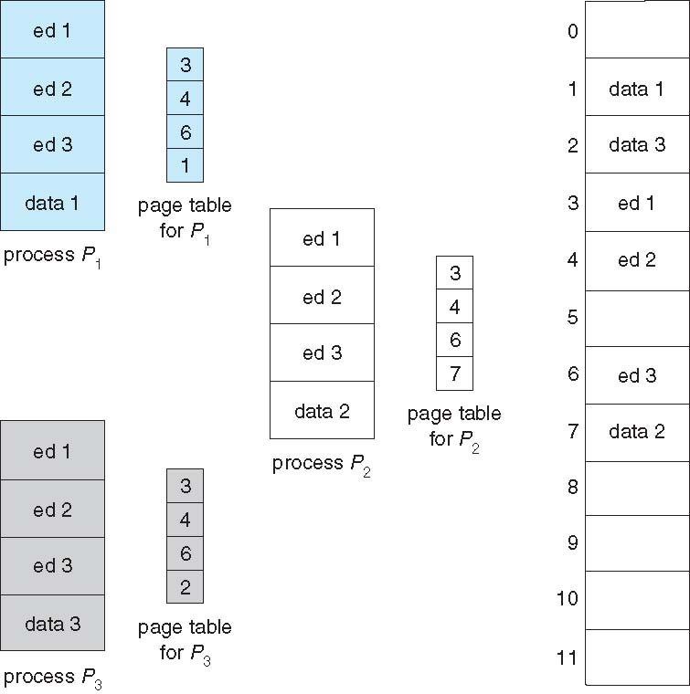
8.4.4 Shared Pages
An advantage of paging is the possibility of sharing common code. This consideration is particularly important in a time-sharing environment. Consider a system that supports 40 users, each of whom executes a text editor. If the text editor consists of 150 KB of code and 50 KB of data space, we need 8,000 KB to support the 40 users. If the code is reentrant code , howerever it can be shared as shown in figure 8.13. Here we see a three-page editor-each page 50 KB in size (the large page size is used to simplify the figure)-being shared among three processes. Each process has its own data page.

Slide 32
Continued…
Reentrant code is non-self-modifying code: it never changes during execution. Thus, two or more processes can execute the same code at the same time. Each process has its own copy of registers and data storage to hold the data for the process's execution. The data for two different processes wilt of course, be different.
Only one copy of the editor need be kept in physical memory. Each user's page table maps onto the same physical copy of the editor, but data pages are mapped onto different frames. Thus, to support 40 users, we need only one copy of the editor (150 KB), plus 40 copies of the 50 KB of data space per user. The total space required is now 2)50 KB instead of 8,000 KB-a significant savings.
Other heavily used programs can also be shared -compilers, window systems, run-time libraries, database systems, and so on.

Slide 33
Virtual memory management
9.1 Background
Virtual memory is a technique that allows the execution of processes that are not completely in memory. One major advantage of this scheme is that programs can be larger than physical memory. Further, virtual memory abstracts main memory into an extremely large, uniform array of storage, separating logical memory as viewed by the user from physical memory.
The requirement that instructions must be in physical memory to be executed seems both necessary and reasonable; but it is also unfortunate, since it limits the size of a program to the size of physical memory. In fact, an examination of real programs shows us that, in many cases, the entire program is not needed. For instance, consider the following:
Programs often have code to handle unusual error conditions. Since these errors seldom, if ever, occur in practice, this code is almost never executed.
Arrays, lists, and tables are often allocated more memory than they actually need. An array may be declared 100 by 100 elements, even though it is seldom larger than 10 by 10 elements. An assembler symbol table may have room for 3,000 symbols, although the average program has less than 200 symbols.
Certain options and features of a program may be used rarely. For instance, the routines on U.S. government computers that balance the budget have not been used in many years.

Slide 34
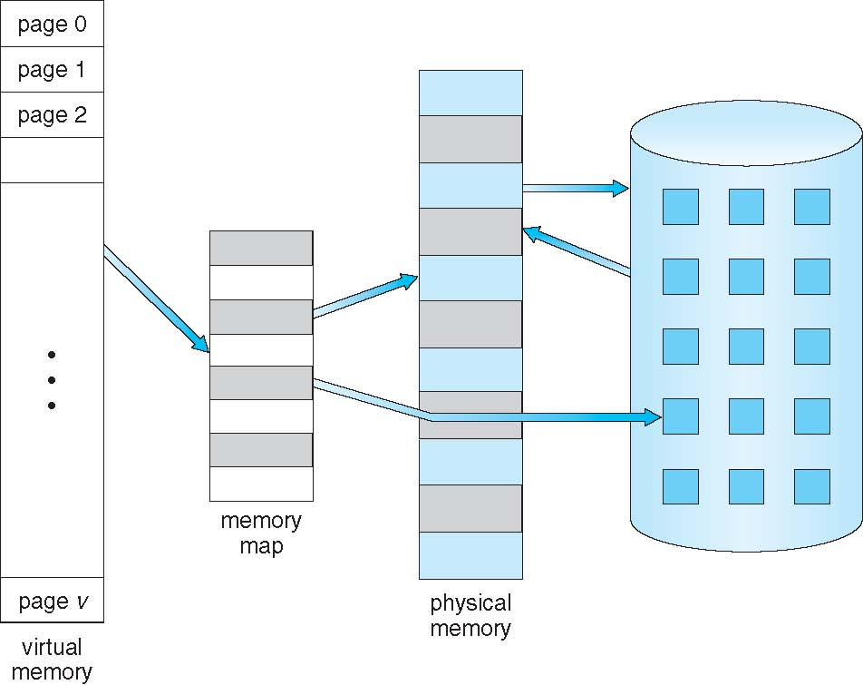
Continued….
9.1 Diagram showing virtual memory that is larger than physical memory

Slide 35
Continued…
The ability to execute a program that is only partially in memory would confer many benefits:
A program would no longer be constrained by the amount of physical memory that is available. Users would be able to write programs for an extremely large virtual address space, simplifying the programming task.
Because each user program could take less physical memory, more programs could be run at the same time, with a corresponding increase in CPU utilization and throughput but with no increase in response time or turnaround time.
Less I/O would be needed to load or swap user programs into memory, so each user program would run faster.
Virtual memory involves the separation of logical memory as perceived by users from physical memory. This separation allows an extremely large virtual memory to be provided for programmers when only a smaller physical memory is available (Figure 9.1).

Slide 36
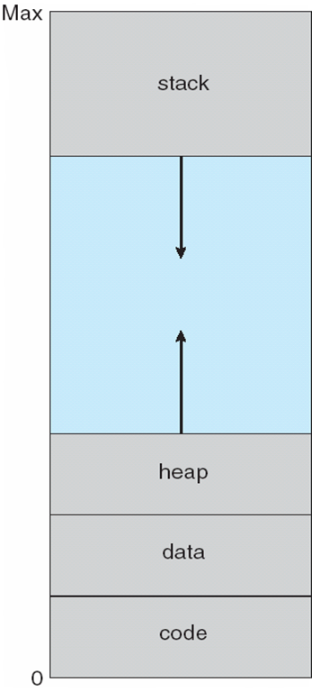
Continued…
The virtual address space of a process refers to the logical (or virtual) view of how a process is stored in memory. Typically, this view is that a process begins at a certain logical address-say, address 0-and exists in contiguous memory, as shown in Figure 9.2.
Note in Figure 9.2 that we allow for the heap to grow upward in memory as it is used for dynamic memory allocation. Similarly, we allow for the stack to grow downward in memory through successive function calls. The large blank space (or hole) between the heap and the stack is part of the virtual address space but will require actual physical pages only if the heap or stack grows.
Virtual address spaces that include holes are known as sparse address spaces.
Figure 9.2 Virtual address space

Slide 37
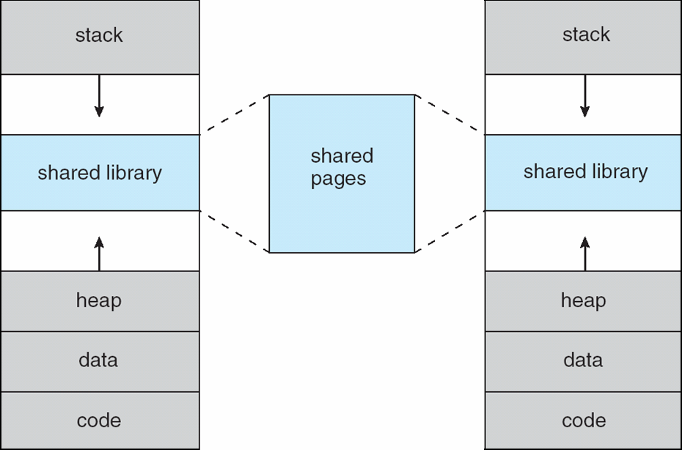
Continued…
In addition to separating logical memory from physical memory, virtual memory allows files and memory to be shared by two or more processes through page sharing. This leads to the following benefits
System libraries can be shared by several processes through mapping of the shared object into a virtual address space. Although each process considers the shared libraries to be part of its virtual address space, the actual pages where the libraries reside in physical memory are shared by all the processes.
Similarly, virtual memory enables processes to share memory. Virtual memory allows one process to create a region of memory that it can share with another process.
Virtual memory can allow pages to be shared during process creation with the fork() system call thus speeding up process creation.
Figure 9.3 Shared library using virtual memory

Slide 38
9.2 demand paging
Consider how an executable program might be loaded from disk into memory. One option is to load the entire program in physical memory at program execution time. However, a problem with this approach is that we may not initially need the entire program in memory. Suppose a program starts with a list of available options from which the user is to select. Loading the entire program into memory results in loading the executable code for all options, regardless of whether an option is ultimately selected by the user or not. An alternative strategy is to load pages only as they are needed. This technique is known as demand paging and is commonly used in virtual memory systems.
A demand-paging system is similar to a paging system with swapping (Figure 9.4) where processes reside in secondary memory (usually a disk). When we want to execute a process, we swap it into memory. Rather than swapping the entire process into memory, however, we use a lazy swapper.
A lazy swapper never swaps a page into memory unless that page will be needed. Since we are now viewing a process as a sequence of pages, rather than as one large contiguous address space, use of the term swapper is technically incorrect.
A swapper manipulates entire processes, whereas a pager is concerned with the individual pages of a process. We thus use pager, rather than swapper, in connection with demand paging.

Slide 39
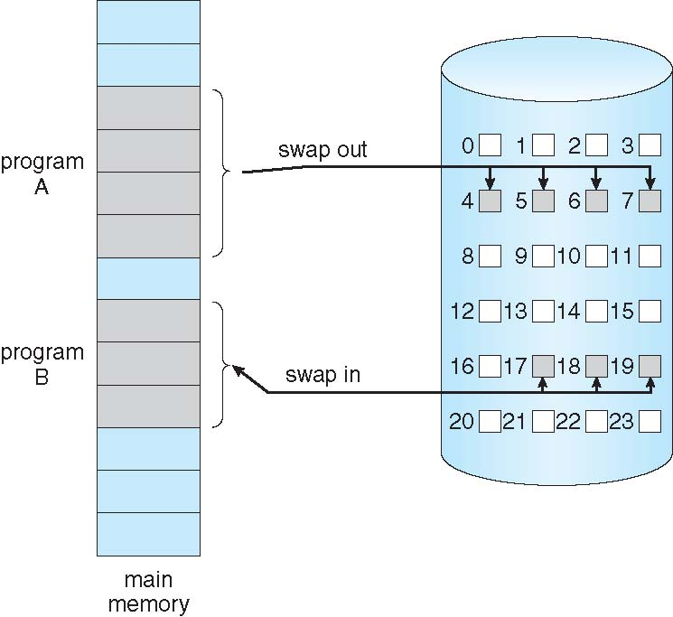
Continued…
Figure 9.4

Slide 40
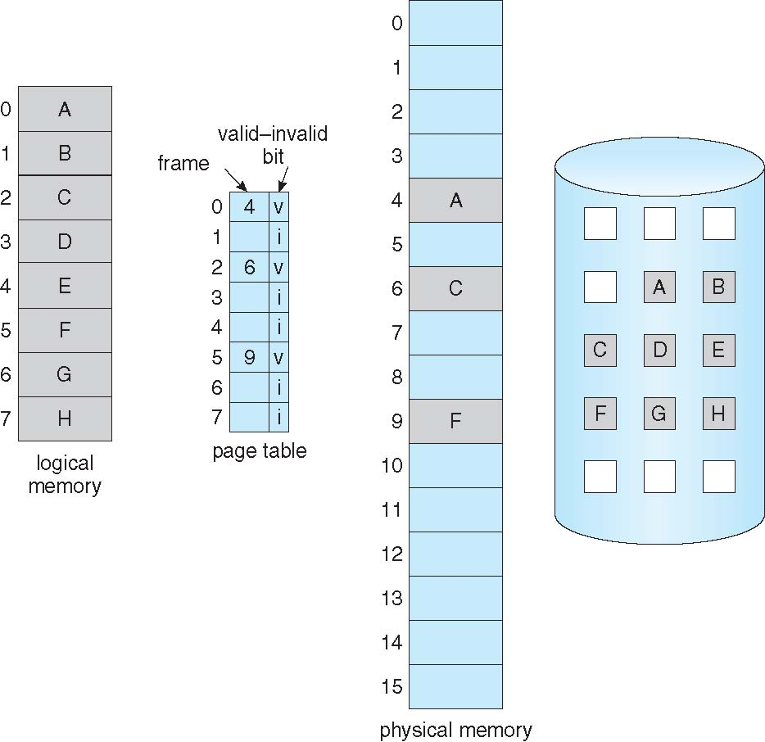
9.2.1 Basic Concepts
When a process is to be swapped in, the pager guesses which pages will be used before the process is swapped out again. Instead of swapping in a whole process, the pager brings only those pages into memory. Thus, it avoids reading into memory pages that will not be used anyway, decreasing the swap time and the amount of physical memory needed.
With this scheme, we need some form of hardware support to distinguish between the pages that are in memory and the pages that are on the disk. The valid -invalid bit can be used for this purpose.
This time, however, when this bit is set to "valid/' the associated page is both legal and in memory. If the bit is set to "invalid/' the page either is not valid (that is, not in the logical address space of the process) or is valid but is currently on the disk. The page-table entry for a page that is brought into memory is set as usual but the page-table entry for a page that is not currently in memory is either simply marked invalid or contains the address of the page on disk. This situation is depicted in Figure 9.5
Figure 9.5

Slide 41
Steps in handling a page fault
But what happens if the process tries to access a page that was not brought into memory? Access to a page marked invalid causes a page fault.
The paging hardware, in translating the address through the page table, will notice that the invalid bit is set, causing a trap to the operating system. This trap is the result of the operating system's failure to bring the desired page into memory. The procedure for handling this page fault is straightforward (Figure 9.6):
We check an internal table (usually kept with the process control block) for this process to determine whether the reference was a valid or an invalid memory access.
If the reference was invalid, we terminate the process. If it was valid, but we have not yet brought in that page, we now page it in.
We find a free frame (by taking one from the free-frame list, for example).
We schedule a disk operation to read the desired page into the newly allocated frame.
When the disk read is complete, we modify the internal table kept with the process and the page table to indicate that the page is now in memory.
We restart the instruction that was interrupted by the trap. The process can now access the page as though it had always been in memory.

Slide 42
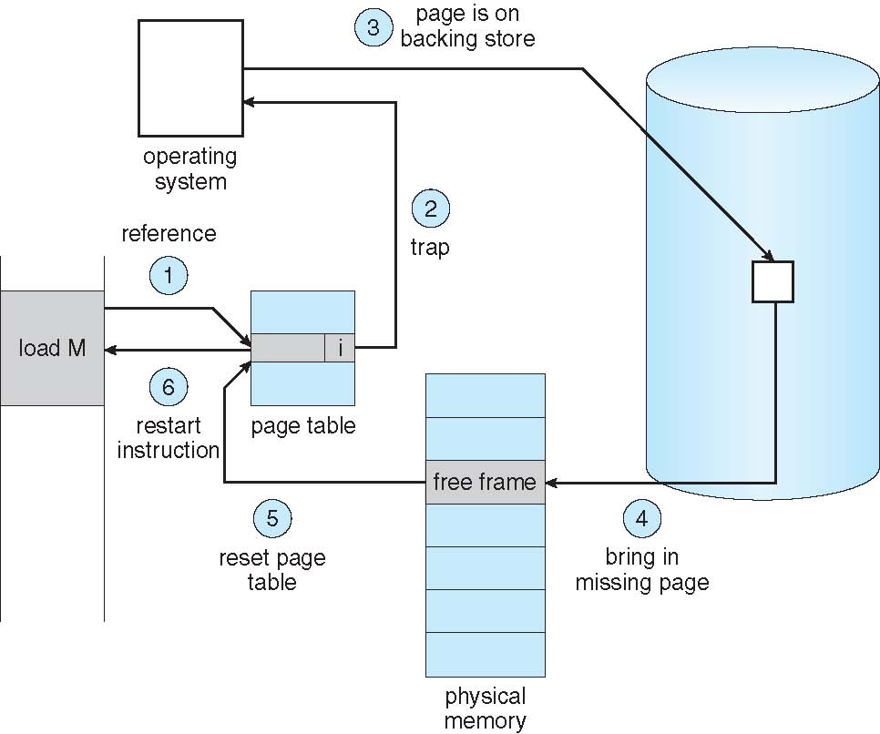
Continued…
Figure 9.6 Steps in handling a page fault . IMPORTANT DIAGRAM
In the extreme case, we can start executing a process with no pages in memory. When the operating system sets the instruction pointer to the first instruction of the process, which is on a non-memory-resident page, the process immediately faults for the page. After this page is brought into memory, the process continues to execute, faulting as necessary until every page that it needs is in memory. At that point it can execute with no more faults. This scheme is pure demand paging. never bring a page into memory until it is required.
The hardware to support demand paging is the same as the hardware for paging and swapping:
Page table. This table has the ability to mark an entry invalid through a valid -invalid bit or a special value of protection bits.
Secondary memory. This memory holds those pages that are not present in main memory. The secondary memory is usually a high-speed disk. It is known as the swap device, and the section of disk used for this purpose is known as swap space.

Slide 43
Continued….
Example :
As a worst-case example, consider a three-address instruction such as ADD the content of A to B, placing the result in C. These are the steps to execute this instruction:
Fetch and decode the instruction (ADD).
Fetch A
Fetch B.
Add A and B.
Store the sum in C.
If we fault when we try to store in C (because C is in a page not currently in memory), we will have to get the desired page, bring it in, correct the page table, and restart the instruction. The restart will require fetching the instruction again, decoding it again, fetching the two operands again, and then adding again. However, there is not much repeated work (less than one complete instruction), and the repetition is necessary only when a page fault occurs.

Slide 44
9.2.2 Performance of Demand Paging
Demand paging can significantly affect the performance of a computer system. To see why, let's compute the effective access time for a demand-paged memory.
For most computer systems, the memory-access time, denoted ma, ranges from 10 to 200 nanoseconds. As long as we have no page faults, the effective access time is equal to the memory access time.
Let p be the probability of a page fault (0 <=p<= 1). We would expect p to be close to zero-that is, we would expect to have only a few page faults. The effective access time is then
effective access time= (1 - p) x ma + p x page fault time
To compute the effective access time, we must know how much time is needed to service a page fault. A page fault causes the following sequence to occur:
Trap to the operating system.
Save the user registers and process state
Determine that the interrupt was a page fault.
Check that the page reference was legal and determine the location of the page on the disk
Issue a read from the disk to a free frame:
a. Wait in a queue for this device until the read request is serviced.
b. Wait for the device seek and/ or latency time.
c. Begin the transfer of the page to a free frame.
While waiting, allocate the CPU to some other user (CPU scheduling, optional).
Receive an interrupt from the disk I/0 subsystem (I/0 completed).
Save the registers and process state for the other user (if step 6 is executed)

Slide 45
Continued..
12. Determine that the interrupt was from the disk
13. Correct the page table and other tables to show that the desired page is now in memory.
14. Wait for the CPU to be allocated to this process again.
15. Restore the user registers, process state, and new page table, and then resume the interrupted instruction.
In any case, we are faced with three major components of the page-fault service time:
Service the page-fault interrupt.
Read in the page.
Restart the process.

Slide 46
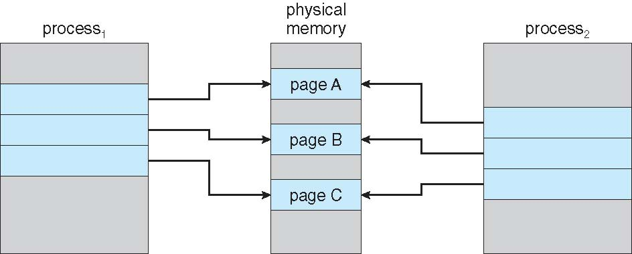
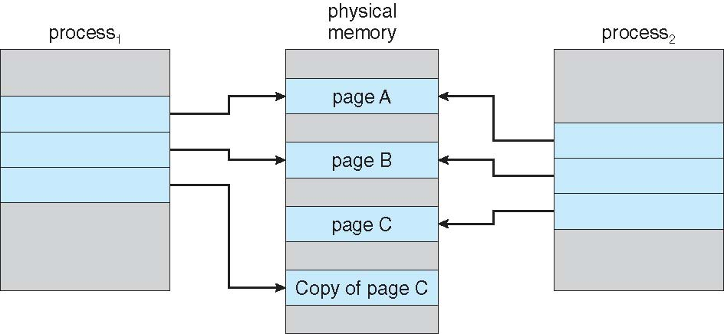
9.3 COPY ON WRITE
Recall that the fork() system call creates a child process that is a duplicate of its parent. Traditionally, fork() worked by creating a copy of the parent's address space for the child, duplicating the pages belonging to the parent. However, considering that many child processes invoke the exec() system call immediately after creation, the copying of the parent's address space may be unnecessary. Instead, we can use a technique known as copy-on-write, which works by allowing the parent and child processes initially to share the same pages. These shared pages are marked as copy-on-write pages, meaning that if either process writes to a shared page, a copy of the shared page is created.
Copy-on-write is illustrated in Figures 9.7 and Figure 9.8, which show the contents of the physical memory before and after process 1 modifies page c.
Figure 9.7 Before process I modifies page C. Figure 9.8 After process 1 modifies page C.

Slide 47
Continued…
For example, assume that the child process attempts to modify a page containing portions of the stack, with the pages set to be copy-on-write. The operating system will create a copy of this page, mapping it to the address space of the child process. The child process will then modify its copied page and not the page belonging to the parent process.
Obviously, when the copy-on-write technique is used, only the pages that are modified by either process are copied; all unmodified pages can be shared by the parent and child processes.
Copy-on-write is a common technique used by several operating systems, including Windows XP, Linux, and Solaris

Slide 48
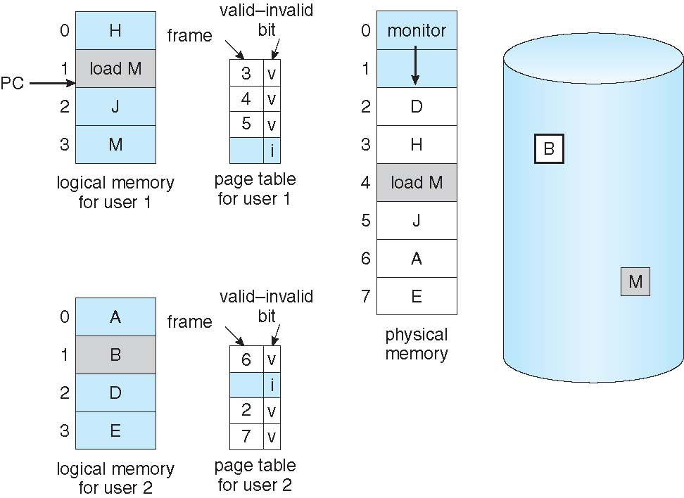
9.4 Page replacement
Need for page replacement
While a user process is executing, a page fault occurs. The operating system determines where the desired page is residing on the disk but then finds that there are no free frames on the free-frame list; all memory is in use (Figure 9.9).
The operating system has several options at this point. It could terminate the user process. However, demand paging is the operating system's attempt to improve the computer system's utilization and throughput. Users should not be aware that their processes are running on a paged system-paging should be logically transparent to the user. So this option is not the best choice.
The operating system could instead swap out a process, freeing all its frames and reducing the level of multiprogramming. The most common solution is page replacement.

Slide 49
9.4.1 Basic Page Replacement
Page replacement takes the following approach. If no frame is free, we find one that is not currently being used and free it. We can free a frame by writing its contents to swap space and changing the page table (and all other tables) to indicate that the page is no longer in memory (Figure 9.10). We can now use the freed frame to hold the page for which the process faulted. We modify the page-fault service routine to include page replacement:
Find the location of the desired page on the disk.
Find a free frame:
If there is a free frame, use it.
If there is no free frame, use a page-replacement algorithm to select a victim frame
Write the victim frame to the disk; change the page and frame tables accordingly.
Read the desired page into the newly freed frame; change the page and frame tables.
Restart the user process
Notice that, if no frames are free, two page transfers (one out and one in) are required. This situation effectively doubles the page-fault service time and increases the effective access time accordingly.
We can reduce this overhead by using a modify bit. When this scheme is used, each page or frame has a modify bit associated with it in the hardware. The modify bit for a page is set by the hardware whenever any word or byte in the page is written into, indicating that the page has been modified.

Slide 50
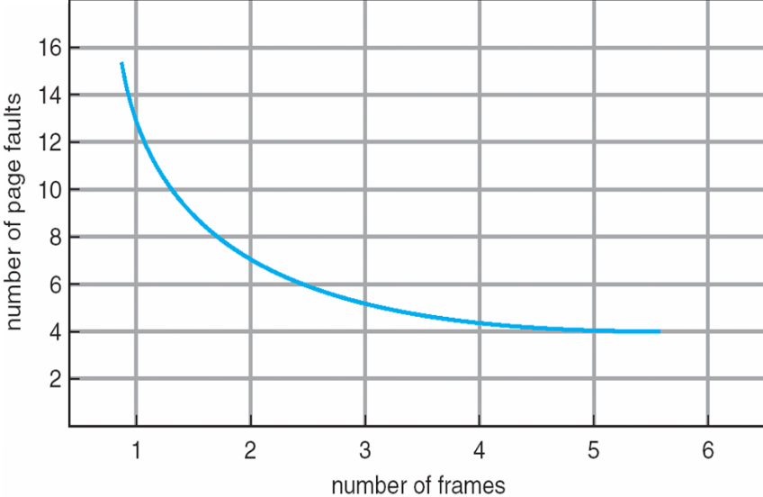
Continue….
We must develop a frame allocation algorithm and a page replacement algorithm. That is, if we have multiple processes in memory, we must decide how many frames to allocate to each process; and when page replacement is required, we must select the frames that are to be replaced. Designing appropriate algorithms to solve these problems is an important task.
There are many different page-replacement algorithms. Every operating system probably has its own replacement scheme.
We evaluate an algorithm by running it on a particular string of memory references and computing the number of page faults.
The string of memory references is called a reference string. We can generate reference strings
artificially (by using a random-number generator, for example), or we can trace a given system and record the address of each memory reference.
To determine the number of page faults for a particular
reference string and page-replacement algorithm, we also need
to know the number of page frames available.
Obviously, as the number of frames available increases,
the number of page faults decreases.
s
Figure 9.1 1 Graph of page faults versus number of frames

Slide 51
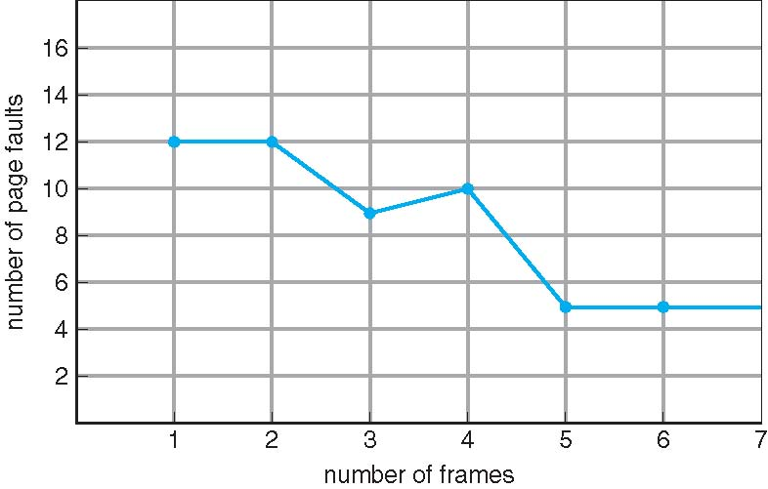
Page replacement algorithms
9.4.2 FIFO Page Replacement
The simplest page-replacement algorithm is a first-in, first-out (FIFO) algorithm. A FIFO replacement algorithm associates with each page the time when that page was brought into memory. When a page must be replaced, the oldest page is chosen. Notice that it is not strictly necessary to record the time when a page is brought in. We can create a FIFO queue to hold all pages in memory. We replace the page at the head of the queue. When a page is brought into memory, we insert it at the tail of the queue.
The FIFO page-replacement algorithm is easy to understand and program. However, its performance is not always good. On the one hand, the page replaced may be an initialization module that was used a long time ago and is no longer needed. On the other hand, it could contain a heavily used variable that was initialized early and is in constant use.
Figure 9.13 shows the curve of page faults for this reference string versus the number of available frames. Notice that the number of faults for four frames (ten) is greater than the number of faults for three frames (nine)! This most unexpected result is known as Belady’s anomaly.
Figure 9.13 Page-fault curve for FIFO replacement
on a reference string

Slide 52
9.4.3 Optimal Page Replacement
Optimal page replacement which has the lowest page-fault rate of all algorithms and will never suffer from Belady's anomaly.
In Optimal page replacement it replaces the page that will not be used for the longest period of time.
Use of this page-replacement algorithm guarantees the lowest possible pagefault rate for a fixed number of frames.
Unfortunately, the optimal page-replacement algorithm is difficult to implement, because it requires future knowledge of the reference string.

Slide 53
9.4.4 LRU Page Replacement
lf the optimal algorithm is not feasible, perhaps an approximation of the optimal algorithm is possible. The key distinction between the FIFO and OPT algorithms (other than looking backward versus forward in time) is that the FIFO algorithm uses the time when a page was brought into memory, whereas the OPT algorithm uses the time when a page is to be used. If we use the recent past as an approximation of the near future, then we can replace the page that has not been used for the longest period of time. This approach is called as least recently used (LRU) algorithm.
LRU replacement associates with each page the time of that page's last use. When a page must be replaced, LRU chooses the page that has not been used for the longest period of time. We can think of this strategy as the optimal page-replacement algorithm looking backward in time, rather than forward.
The LRU policy is often used as a page-replacement algorithm and is considered to be good. The major problem is how to implement LRU replacement. An LRU page-replacement algorithm may require substantial hardware assistance. The problem is to determine an order for the frames defined by the time of last use. Two implementations are feasible
Counters. In the simplest case, we associate with each page-table entry a time-of-use field and add to the CPU a logical clock or counter. The clock is incremented for every memory reference. Whenever a reference to a page is made, the contents of the clock register are copied to the time-of-use field in the page-table entry for that page. In this way, we always have the "time" of the last reference to each page. We replace the page with the smallest time value. This scheme requires a search of the page table to find the LRU page and a write to memory (to the time-of-use field in the page table) for each memory access.

Slide 54
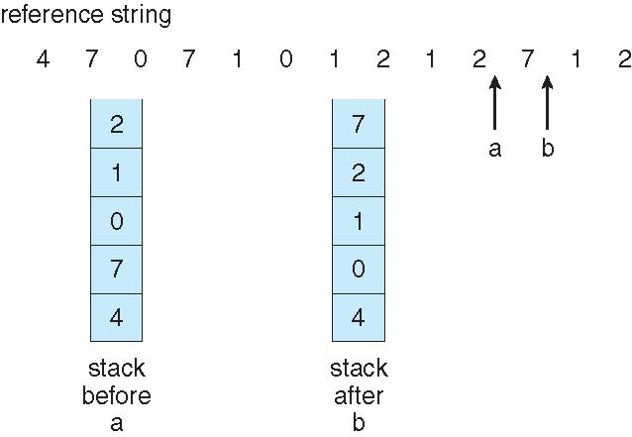
Continued…
Stack Another approach to implementing LRU replacement is to keep a stack of page numbers. Whenever a page is referenced, it is removed from the stack and put on the top. In this way, the most recently used page is always at the top of the stack and the least recently used page is always at the bottom (Figure 9.16) Because entries must be removed from the middle of the stack, it is best to implement this approach by using a doubly linked list with a head pointer and a tail pointer. Removing a page and putting it on the top of the stack then requires changing six pointers at worst. Each update is a little more expensive, but there is no search for a replacement; the tail pointer points to the bottom of the stack, which is the LRU page.
Figure 9.16 Use of a stack to record the most recent page references.

Slide 55
9.4.5 LRU-Approximation Page Replacement
Few computer systems provide sufficient hardware support for true LRU page replacement. Some systems provide no hardware support, and other page replacement algorithms (such as a FIFO algorithm) must be used. Many systems provide some help, however, in the form of a reference bit. The reference bit for a page is set by the hardware whenever that page is referenced.
Initially, all bits are cleared (to 0) by the operating system. As a user process executes, the bit associated with each page referenced is set (to 1) by the hardware. After some time, we can determine which pages have been used and which have not been used by examining the reference bits, although we do not know the order of use.
9.4.5.1 Additional-Reference-Bits Algorithm
We can gain additional ordering information by recording the reference bits at regular intervals. We can keep an 8-bit byte for each page in a table in memory. At regular intervals (say, every 100 milliseconds), a timer interrupt transfers control to the operating system. The operating system shifts the reference bit for each page into the high-order bit of its 8-bit byte, shifting the other bits right by 1 bit and discarding the low-order bit.
These 8-bit shift registers contain the history of page use for the last eight time periods. If the shift register contains 00000000, for example, then the page has not been used for eight time periods; a page that is used at least once in each period has a shift register value of 11111111.
A page with a history register value of 11000100 has been used more recently than one with a value of 01110111. If we interpret these 8-bit bytes as unsigned integers, the page with the lowest number is the LRU page, and it can be replaced.

Slide 56
Continued…
9.4.5.2 Second-Chance Algorithm
The basic algorithm of second-chance replacement is a FIFO replacement algorithm. When a page has been selected, however, we inspect its reference bit. If the value is 0, we proceed to replace this page; but if the reference bit is set to 1, we give the page a second chance and move on to select the next FIFO page.
When a page gets a second chance, its reference bit is cleared, and its arrival time is reset to the current time. Thus, a page that is given a second chance will not be replaced until all other pages have been replaced. One way to implement the second-chance algorithm (sometimes referred to as the clock algorithm) is as a circular queue.
A pointer (that is, a hand on the clock) indicates which page is to be replaced next. When a frame is needed, the pointer advances until it finds a page with a 0 reference bit. As it advances, it clears the reference bits (Figure 9.17).
Once a victim page is found, the page is replaced, and the new page is inserted in the circular queue in that position. Notice that, in the worst case, when all bits are set, the pointer cycles through the whole queue, giving each page a second chance. It clears all the reference bits before selecting the next page for replacement. Second-chance replacement degenerates to FIFO replacement if all bits are set.

Slide 57
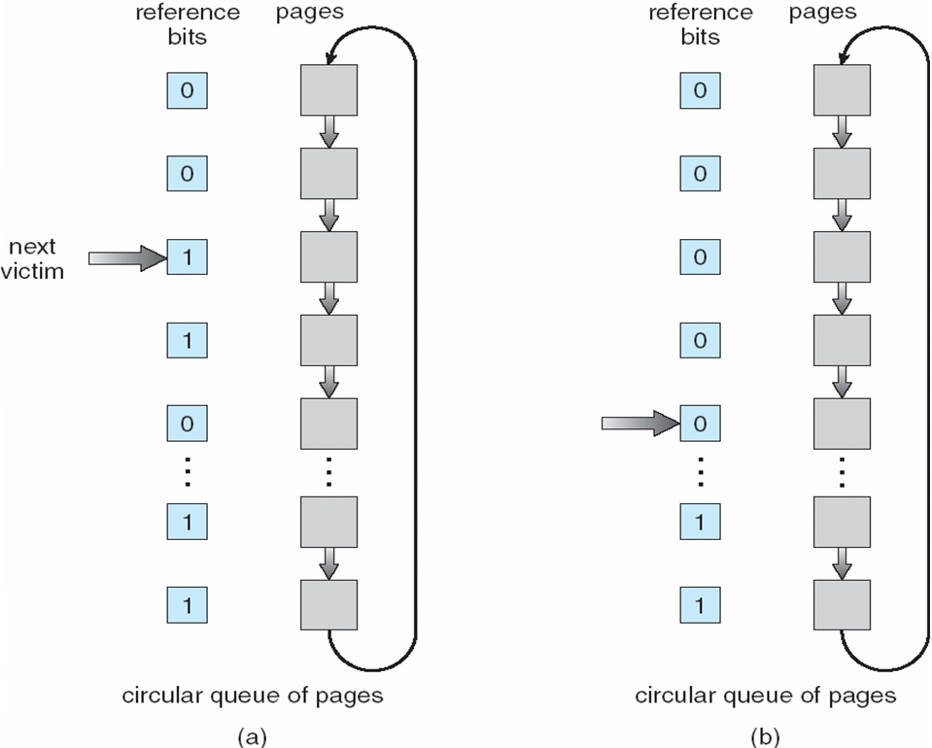
Continued….
Figure 9.17 Second-chance (clock) page-replacement algorithm
9.4.5.3 Enhanced Second-Chance Algorithm
We can enhance the second-chance algorithm by considering the reference bit and the modify bit as an ordered pair. With these two bits, we have the following four possible classes:
(0, 0) neither recently used nor modified -best page to replace.
(0, 1) not recently used hut modified-not quite as good, because the page will need to be written out before replacement.
(1, 0) recently used but clean-probably will be used again soon.
(1, 1) recently used and modified -probably will be used again soon, and the page will be need to be written out to disk before it can be replaced.

Slide 58
9.4.6 Counting-Based Page Replacement
There are many other algorithms that can be used for page replacement. For example, we can keep a counter of the number of references that have been made to each page and develop the following two schemes.
The least frequently used (LFU) page-replacement algorithm requires that the page with the smallest count be replaced. The reason for this selection is that an actively used page should have a large reference count. A problem arises, however, when a page is used heavily during the initial phase of a process but then is never used again.
The most frequently used (MFU) page-replacement algorithm is based on the argument that the page with the smallest count was probably just brought in and has yet to be used.

Slide 59
9.5 Allocation of frames
We turn next to the issue of allocation. How do we allocate the fixed amount of free memory among the various processes? If we have 93 free frames and two processes, how many frames does each process get?
The simplest case is the single-user system. Consider a single-user system with 128 KB of memory composed of pages 1 KB in size. This system has 128 frames. The operating system may take 35 KB, leaving 93 frames for the user process. Under pure demand paging, all 93 frames would initially be put on the free-frame list. When a user process started execution, it would generate a sequence of page faults. The first 93 page faults would all get free frames from the free-frame list. When the free-frame list was exhausted, a page-replacement algorithm would be used to select one of the 93 in-memory pages to be replaced with the 94th, and so on. When the process terminated, the 93 frames would once again be placed on the free-frame list.
9.5.1 Minimum Number of Frames
Our strategies for the allocation of frames are constrained in various ways. We cannot, for example, allocate more than the total number of available frames (unless there is page sharing). We must also allocate at least a minimum number of frames. Here, we look more closely at the latter requirement.
One reason for allocating at least a minimum number of frames involves performance. Obviously, as the number of frames allocated to each process decreases, the page-fault rate increases, slowing process execution. In addition, remember that when a page fault occurs before an executing instruction is complete, the instruction must be restarted

Slide 60
Continued…
The minimum number of frames is defined by the computer architecture. For example, the move instruction for the PDP-11 includes more than one word for some addressing modes, and thus the instruction itself may straddle two pages.
The worst-case scenario occurs in computer architectures that allow multiple levels of indirection (for example, each 16-bit word could contain a 15-bit address plus a 1-bit indirect indicator). Theoretically, a simple load instruction could reference an indirect address that could reference an indirect address (on another page) that could also reference an indirect address (on yet another page), and so on, until every page in virtual memory had been touched. Thus, in the worst case, the entire virtual memory must be in physical memory. To overcome this difficulty, we must place a limit on the levels of indirection.
Whereas the minimum number of frames per process is defined by the architecture, the maximum number is defined by the amount of available physical memory.
9.5.2 Allocation Algorithms
The easiest way to split m frames among n processes is to give everyone an equal share, m/n frames. For instance, if there are 93 frames and five processes, each process will get 18 frames. The three leftover frames can be used as a free-frame buffer pool. This scheme is called equal allocation.

Slide 61


Continued…
An alternative is to recognize that various processes will need differing amounts of memory. Consider a system with a 1-KB frame size. If a small student process of 10 KB and an interactive database of 127 KB are the only two processes running in a system with 62 free frames, it does not make much sense to give each process 31 frames. The student process does not need more than 10 frames, so the other 21 are, strictly speaking, wasted.
To solve this problem, we can use proportional algorithm in which we allocate available memory to each process according to its size. Let the size of the virtual memory for process pi be si and define
Then, if the total number of available frames is m, we allocate ai frames to process pi, where ai is approximately

Slide 62
Continued…
With proportional allocation, we would split 62 frames between two processes, one of 10 pages and one of 127 pages, by allocating 4 frames and 57 frames, respectively, since
10/137 x 62 ~ 4, and
127/137 X 62 ~57.
In this way, both processes share the available frames according to their "needs," rather than equally.
In both equal and proportional allocation, of course, the allocation may vary according to the multiprogramming level. If the multiprogramming level is increased, each process will lose some frames to provide the memory needed for the new process. Conversely, if the multiprogramming level decreases, the frames that were allocated to the departed process can be spread over the remaining processes.

Slide 63
9.5.3 Global versus Local Allocation
Another important factor in the way frames are allocated to the various processes is page replacement. With multiple processes competing for frames, we can classify page-replacement algorithms into two broad categories. Global and local replacement.
Global replacement allows a process to select a replacement frame from the set of all frames, even if that frame is currently allocated to some other process; that is, one process can take a frame from another. Local replacement requires that each process select from only its own set of allocated frames.
For example, consider an allocation scheme wherein we allow high-priority processes to select frames from low-priority processes for replacement. A process can select a replacement from among its own frames or the frames of any lower-priority process. This approach allows a high-priority process to increase its frame allocation at the expense of a low-priority process. With a local replacement strategy, the number of frames allocated to a process does not change. With global replacement, a process may happen to select only frames allocated to other processes, thus increasing the number of frames allocated to it (assuming that other processes do not choose its frames for replacement).
One problem with a global replacement algorithm is that a process cannot control its own page-fault rate. The set of pages in memory for a process depends not only on the paging behavior of that process but also on the paging behavior of other processes.
Under local replacement, the set of pages in memory for a process is affected by the paging behavior of only that process.

Slide 64
9.6 Thrashing
If the number of frames allocated to a low-priority process falls below the minimum number required by the computer architecture, we must suspend that process's execution. We should then page out its remaining pages, freeing all its allocated frames. This provision introduces a swap-in, swap-out level of intermediate CPU scheduling.
In fact, look at any process that does not have "enough" frames. If the process does not have the number of frames it needs to support pages in active use, it will quickly page-fault. At this point, it must replace some page. However, since all its pages are in active use, it must replace a page that will be needed again right away. Consequently, it quickly faults again, and again, and again, replacing pages that it must back in immediately. This high paging activity is called Thrashing. A process is thrashing if it is spending more time in paging than executing.
9.6.1 Cause of Thrashing
Thrashing results in severe performance problems. Consider the following scenario, which is based on the actual behavior of early paging systems.
The operating system monitors CPU utilization. If CPU utilization is too low, we increase the degree of multiprogramming by introducing a new process to the system. A global page-replacement algorithm is used; it replaces pages without regard to the process to which they belong. Now suppose that a process enters a new phase in its execution and needs more frames. It starts faulting and taking frames away from other processes. These processes need those pages, however, and so they also fault, taking frames from other processes. These faulting processes must use the paging device to swap pages in and out. As they queue up for the paging device, the ready queue empties. As processes wait for the paging device, CPU utilization decreases.

Slide 65
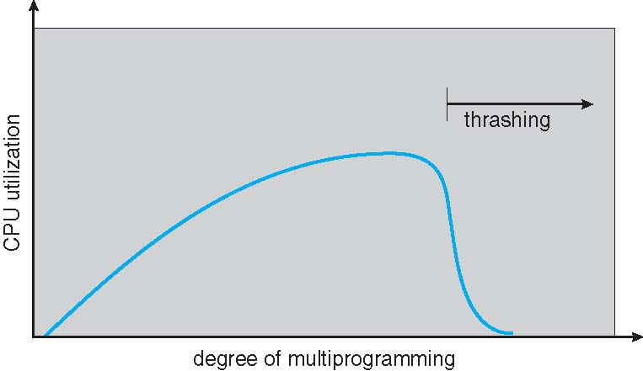
Continued..
The CPU scheduler sees the decreasing CPU utilization and increases the degree of multiprogramming as a result. The new process tries to get started by taking frames from running processes, causing more page faults and a longer queue for the paging device. As a result, CPU utilization drops even further, and the CPU scheduler tries to increase the degree of multiprogramming even more. Thrashing has occurred, and system throughput plunges. The page fault rate increases tremendously. As a result, the effective memory-access time increases. No work is getting done, because the processes are spending all their time paging. This phenomenon is illustrated in Figure 9.18, in which CPU utilization is plotted against the degree of multiprogramming.
As the degree of multiprogramming increases, CPU utilization also decreases, although more slowly, until a maximum is reached. If the degree of multiprogramming is increased even further, thrashing sets in, and CPU utilization drops sharply. At this point, to increase CPU utilization and stop thrashing, we must decrease the degree of multiprogramming.
Figure 9.18 Thrashing.

Slide 66
Continued…
To prevent thrashing, we must provide a process with as many frames as it needs. But how do we know how many frames it "needs"? There are several techniques. The working-set strategy starts by looking at how many frames a process is actually using. This approach defines the locality model of process execution.
The locality model states that, as a process executes, it moves from locality to locality. A locality is a set of pages that are actively used together. A program is generally composed of several different localities, which may overlap.
For example, when a function is called, it defines a new locality. In this locality, memory references are made to the instructions of the function call, its local variables, and a subset of the global variables. When we exit the function, the process leaves this locality, since the local variables and instructions of the function are no longer in active use. We may return to this locality later

Slide 67

9.6.2 Working-Set Model
As mentioned, the working set model is based on the assumption of locality. This model uses a parameter to define working set window. The idea is to examine the most recent page references is the working set. If it is no longer being used, it will drop from the working set time units after its last reference.
For example, given the sequence of memory references shown in Figure 9.20. if =10 memory references, then the working set at time t1 is {1, 2, 5, 6, 7}. By time t2, the working set h as changed to {3, 4}.
The accuracy of the working set depends on the selection of
If is too small, it will not encompass the entire locality; if is too large, it may overlap several localities.
The most important property of the working set, then, is its size. If we compute the working-set size, WSSi, for each process in the system, we can then consider that
where Dis the total demand for frames. Each process is actively using the pages in its working set. Thus, process i needs WSSi frames. If the total demand is greater than the total number of available frames (D > m), thrashing will occur, because some processes will not have enough frames.

Slide 68
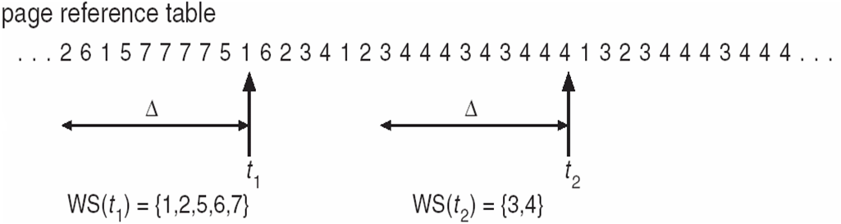
Continued…
This working-set strategy prevents thrashing while keeping the degree of multiprogramming as high as possible. Thus, it optimizes CPU utilization.
The difficulty with the working-set model is keeping track of the working set. The working-set window is a moving window. At each memory reference, a new reference appears at one end and the oldest reference drops off the other end. A page is in the working set if it is referenced anywhere in the working-set window.

Slide 69
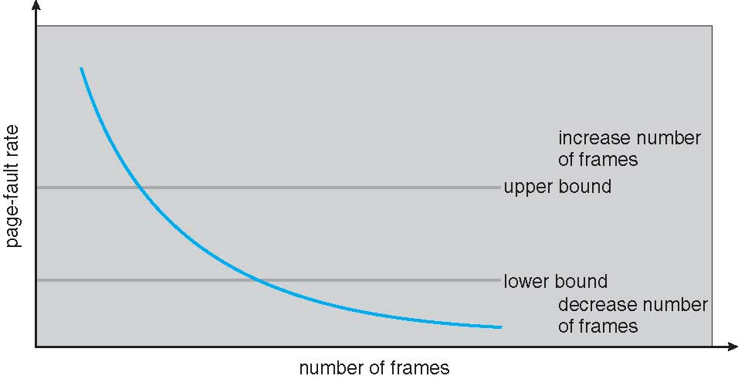
9.6.3 Page-Fault Frequency
The working-set model is successful, and knowledge of the working set can be useful for prepaging, but it seems a clumsy way to control thrashing. A strategy that uses the page fault frequency takes a more direct approach.
The specific problem is how to prevent thrashing. Thrashing has a high page-fault rate. Thus, we want to control the page-fault rate. When it is too high, we know that the process needs more frames. Conversely, if the page-fault rate is too low, then the process may have too many frames. We can establish upper and lower bounds on the desired page-fault rate (Figure 9.21). If the actual page-fault rate exceeds the upper limit, we allocate the process another frame; if the page-fault rate falls below the lower limit, we remove a frame from the process. Thus, we can directly measure and control the page-fault rate to prevent thrashing.
Figure 9.21 Page-fault frequency.

